Slide 1
Credit Card Payment Default Analysis
DAB 103 : Analytical Tools & Decision Making

Slide 2
Team Introduction:
Jibina Francis
Srilakshmi Gummadidala
Ambily Treesa Varghese
Satya Akhil Govvala
Dileep Sathyan

Slide 3
Background / Motivation:
A Bank gets 100s of new Credit Card applications every single day from their users. Although the bank might give their users a Credit Card with a minimum line to increase their customer acquisition, it is still a riskier business & it is one of the biggest challenges any financial Institution faces when it comes to repayment of the used Credit from their customers.
Identifying the users who might go default within the first few months of Credit Card allocation based on their performance in their repayment will mitigate the risks with credit lending and avoid losses.

Slide 4
Problem Statement:
Financial institutions need an insight on individuals to classify whether a person can be a defaulter in future before approving a credit card.
This will reduce the rate of defaults thus reducing losses.

Slide 5
Project Proposal
Our project team will create a predictive analytics machine learning model for credit card default and provide valuable insights and help mitigate risks for financial institutions.
Our team will emphasize the importance for reducing credit card default by using classification data mining technique to accurately predict the probability of default credit card clients.

Slide 6
Analysis Questions:
Which variables in the dataset have stronger correlation with the users going default?
Find the distribution of categorical variables towards the credit card payment default.
Create insightful data visualisations using Seaborn library in Python.
Build a Machine Learning model using RandomForest classifier to predict the users who have higher probability of going default.
Finally, estimate the accuracy of the model using a Confusion Matrix.

Slide 7
Dataset Description:
The analysis will be based on Default of Credit Card Clients Data Set obtained from UCI Machine Learning Repository.
The dataset includes data for 6 months, from April to September 2005.

Slide 8
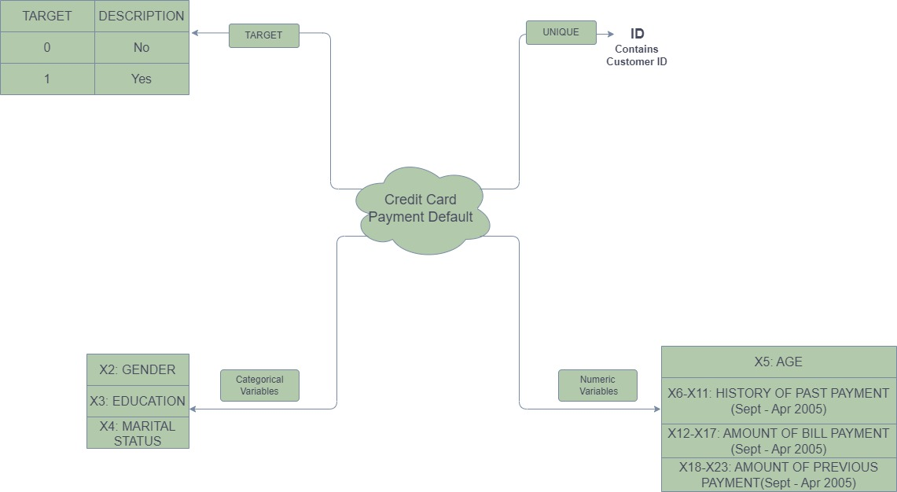
Attribute Description:

